Slide 1

Geometry
Unit 11, Lesson 6 Triangle Inequality Theorem Volume 2, pg. 207

Slide 2


Benchmarks
MA.912.GR.1.3
Prove relationships and theorems about triangles. Solve mathematical and real-world problems involving postulates, relationships, and theorems of triangles.
MA.912.LT.4.10
Judge the validity of arguments and give counterexamples to disprove statements.
volume 2, pg. 207

Slide 3
Integrated Mathematical Thinking and Reasoning Standards
MA.K12.MTR.1.1 Actively participate in effortful learning both individually and collectively.
MA.K12.MTR.2.1 Demonstrate understanding by representing problems in multiple ways.
MA.K12.MTR.4.1 Engage in discussions that reflect on the mathematical thinking of self and others.
MA.K12.MTR.5.1 Use patterns and structure to help understand and connect mathematical concepts.
MA.K12.MTR.6.1 Assess the reasonableness of solutions.
volume 2, pg. 207

Slide 4

Learning Targets
I can determine if a set of triangle side lengths can be used to construct a triangle.
I can use the triangle inequality theorem to prove relationships in triangles.
volume 2, pg. 207

Slide 5

Warm-Up
volume 2, pg. 208

Slide 6
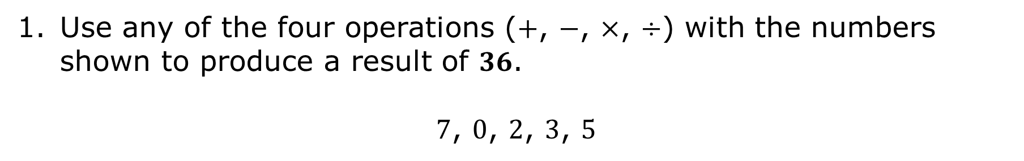
11.6.1 Warm-Up: Number Riddle
Use any of the four operations ($+$, $−$, $×$, $÷$) with the numbers shown to produce a result of $36$.
$7$, $0$, $2$, $3$, $5$
volume 2, pg. 208

Slide 7

Exploration
volume 2, pg. 208

Slide 8

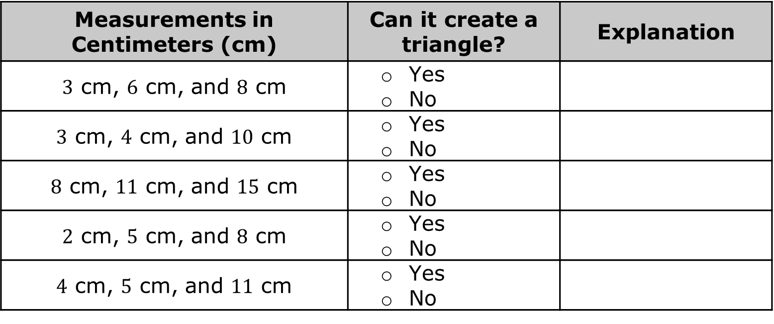
11.6.2 Exploration: Triangle Inequality Theorem
With your partner, use a ruler to determine if the given measurements can be used to create a triangle. Then, complete the table.
Measurements in Centimeters (cm) | Can it create a triangle? | Explanation
$3$ cm, $6$ cm, and $8$ cm | Yes No
$3$ cm, $4$ cm, and $10$ cm | Yes No
$8$ cm, $11$ cm, and $15$ cm | Yes No
$2$ cm, $5$ cm, and $8$ cm | Yes No
$4$ cm, $5$ cm, and $11$ cm | Yes No
volume 2, pg. 208

Slide 9
What similarities did you notice about the measurements that could create a triangle?
What similarities did you notice about the measurements that could not create a triangle?
Make a conjecture about how to determine if side lengths can be used to construct a triangle if you cannot draw it.
volume 2, pg. 208

Slide 10
Ask two other pairs of partners for the conjectures they wrote. Listen to their conjectures and write a summary. You are the only person who should write in the first column of the table. Have the person initial next to your summary stating that your summary was accurate.
My Summary of the Conjecture | Initials
volume 2, pg. 209

Slide 11
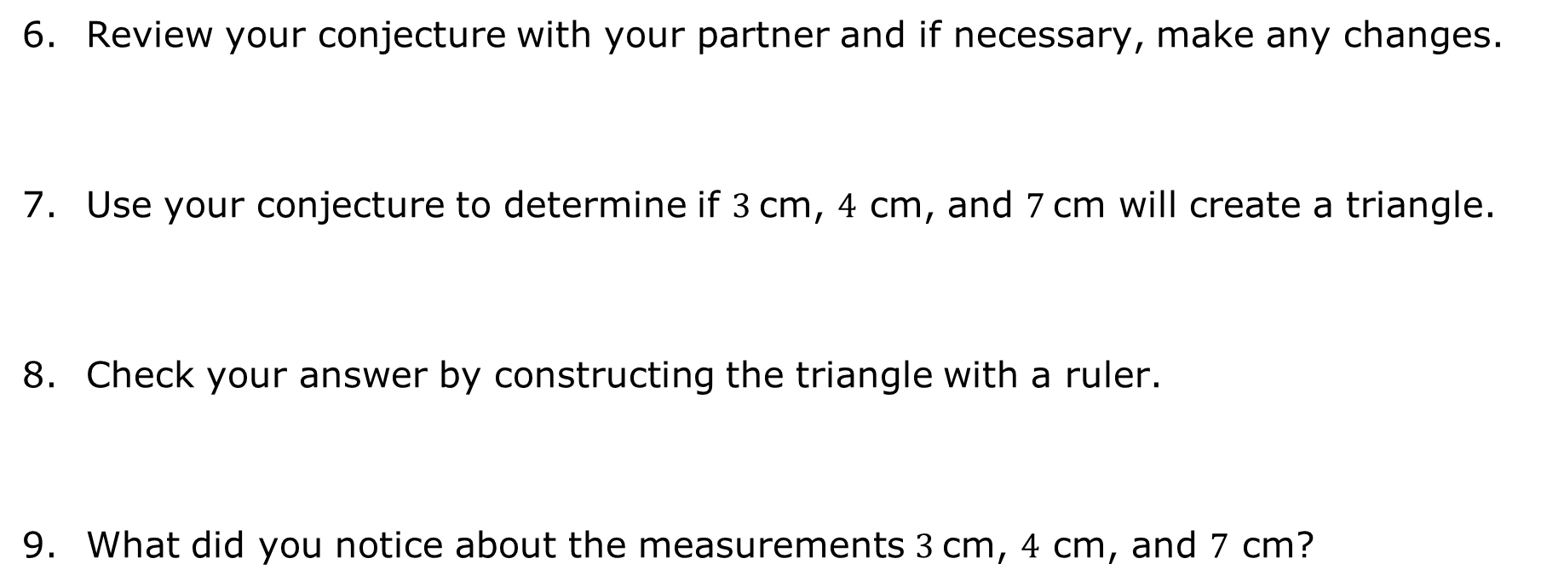
Review your conjecture with your partner and if necessary, make any changes.
Use your conjecture to determine if $3$cm, $4$ cm, and $7$cm will create a triangle.
Check your answer by constructing the triangle with a ruler.
What did you notice about the measurements $3$cm, $4$ cm, and $7$ cm?
volume 2, pg. 209

Slide 12

Adjust your conjecture if needed.
Triangle Inequality Theorem
The sum of the lengths of any two sides of a triangle is greater than the length of the third side.
If three segments have lengths such that the sum of any two is greater than the third, then a triangle can be constructed from the segments.
volume 2, pg. 209

Slide 13

Try It
volume 2, pg. 210

Slide 14

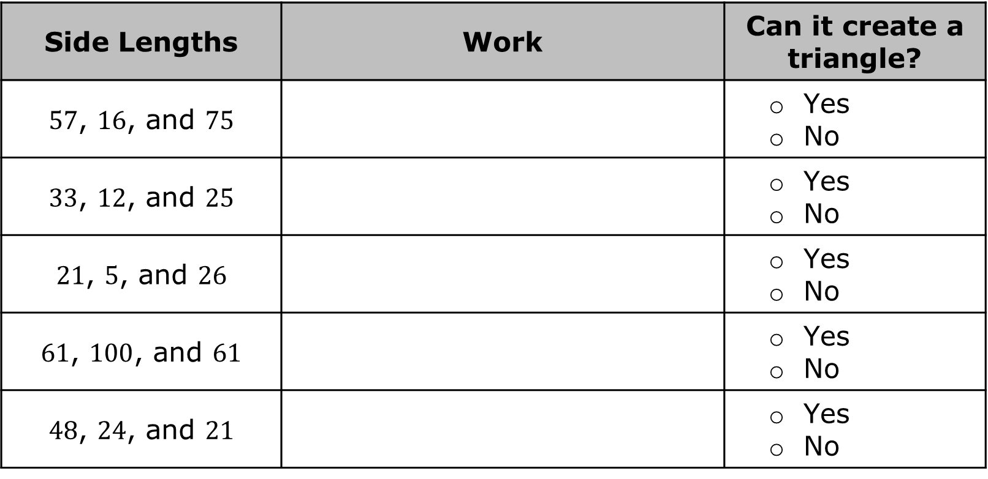
11.6.3 Try It: Triangle Inequality Theorem
Complete the table.
Side Lengths | Work | Can it create a triangle?
$57$, $16$, and $75$ |  | Yes No
$33$, $12$, and $25$ |  | Yes No
$21$, $5$, and $26$ |  | Yes No
$61$, $100$, and $61$ |  | Yes No
$48$, $24$, and $21$ |  | Yes No
volume 2, pg. 210

Slide 15
Exploration
volume 2, pg. 210

Slide 16
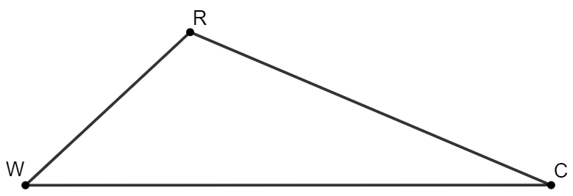
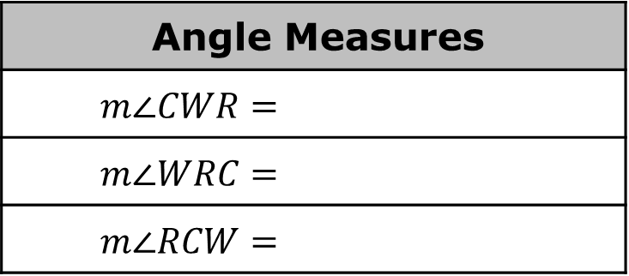

11.6.4 Exploration: Relating Angle Measures and Sides of Triangles
$∆RCW$ is shown, where $WC=24, CR=18$, and $RW=10$.
Use a protractor to find the angle measures. Record your answers in the table.
Angle Measures
$$m∠CWR=$$
$$m∠WRC=$$
$$m∠RCW=$$
volume 2, pg. 210

Slide 17
List the side lengths in order from longest to shortest.
List the angles in order from largest to smallest.
What do you notice about the size of the angle compared to the length of the opposite side?
volume 2, pg. 210/211

Slide 18

Guided Instruction
volume 2, pg. 211

Slide 19
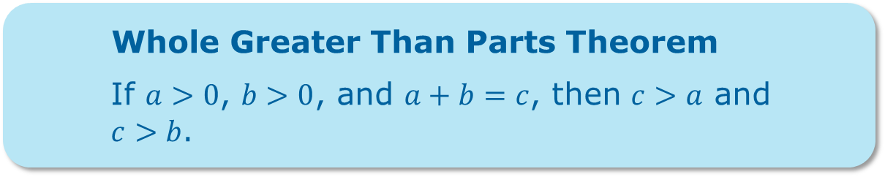
11.6.5 Guided Instruction: Proving Inequality in a Triangle
If two sides of a triangle are unequal in measure, then the angle opposite the longer side has the greater measure.
If two angles of a triangle are unequal in measure, then the side opposite the angle with the greater measure is the longer side.
Whole Greater Than Parts Theorem
If $a>0$, $b>0$, and $a+b=c$, then $c>a$ and
$c>b$.
volume 2, pg. 211

Slide 20
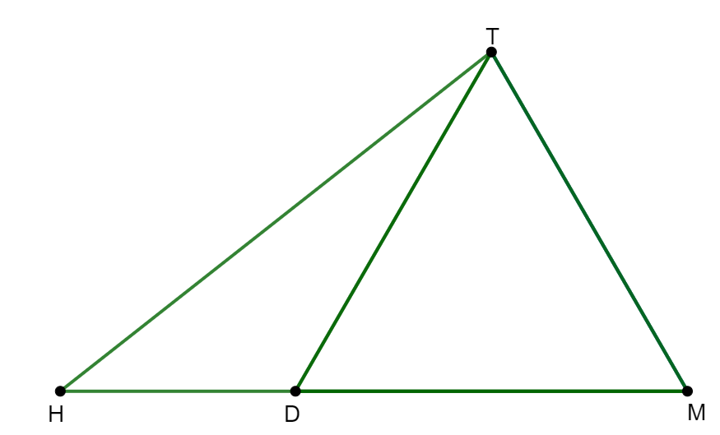

1. $∆THM$ is shown, with $\overline{TD}$ creating $∆HTD$ and $∆DTM$, where $∆DTM$ is an equilateral triangle.
Given: $∆DTM$ is equilateral; $m∠DTH=22°$
Prove: $HM>HT$
volume 2, pg. 212

Slide 21
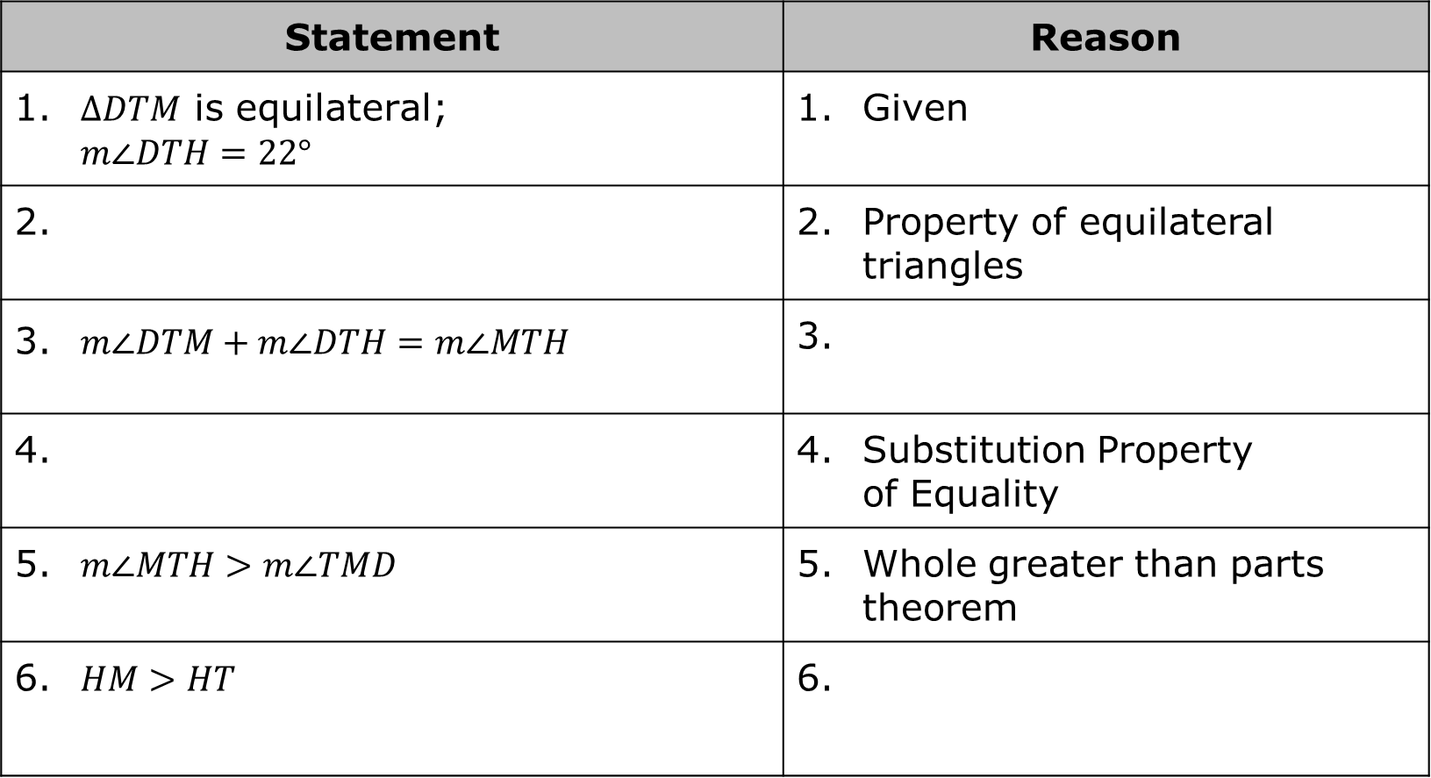
Statement | Reason
1. $∆DTM$ is equilateral; $$m∠DTH=22°$$ | Given
2. | Property of equilateral triangles
3. $m∠DTM+m∠DTH=m∠MTH$ | 3.
4. | Substitution Property of Equality
5. $m∠MTH>m∠TMD$ | Whole greater than parts theorem
6. $HM>HT$ | 6.
volume 2, pg. 212

Slide 22
Try It
volume 2, pg. 212

Slide 23
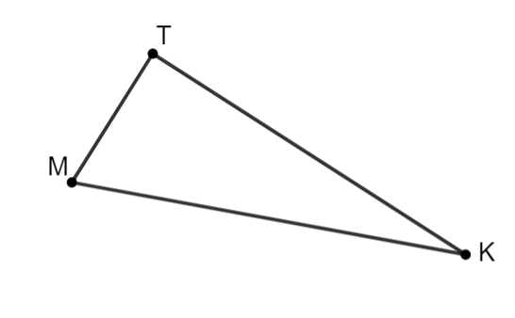
11.6.6 Try It: Triangle’s Angle Measures
1. $∆TKM$ is shown, where $KT=32$, $MK=34$, and $TM=13$. List the angles in order from least to greatest.
volume 2, pg. 212

Slide 24

Wrap-Up
volume 2, pg. 213

Slide 25
11.6.7 Wrap-Up: Cool Down
List three side lengths that would not make a triangle. Explain how you know those sides would not make a triangle.
List three side lengths that would make a triangle. Explain how you know those sides would make a triangle.
volume 2, pg. 213

